Slide 1
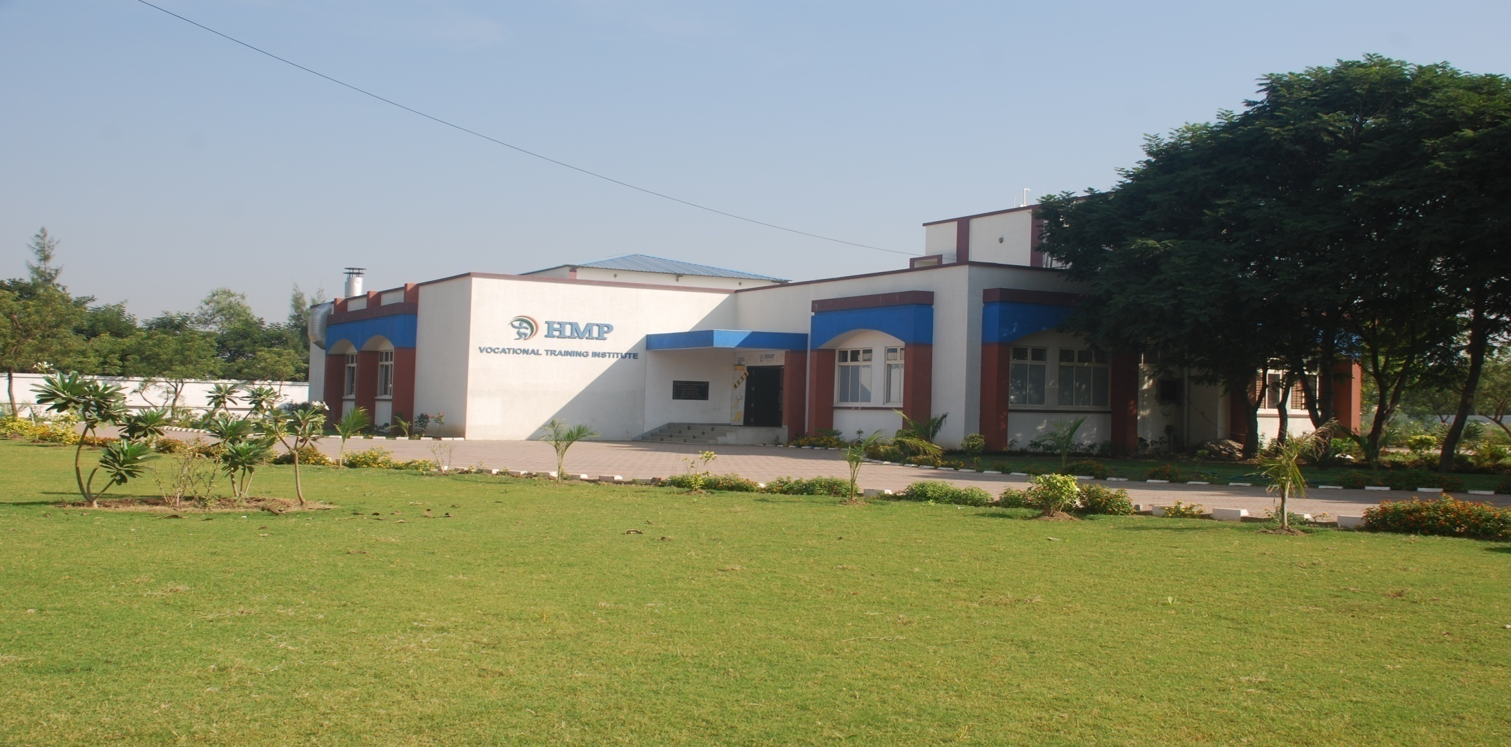
WELCOME TO HMP VOCATIONAL TRAINING INSTITUTE, KHAROD
“MANAGED BY THE ANKLESHWAR PROGRESSIVE EDUCATIONAL TRUST”
GUIDANCE & SUPPORT BY L&T__***__ WITH NCVT MES CERTIFICATIONS

Slide 2
HIGHLIGHTS OF HMP-VOCATIONAL TRAINING INSTITUTE

Slide 3
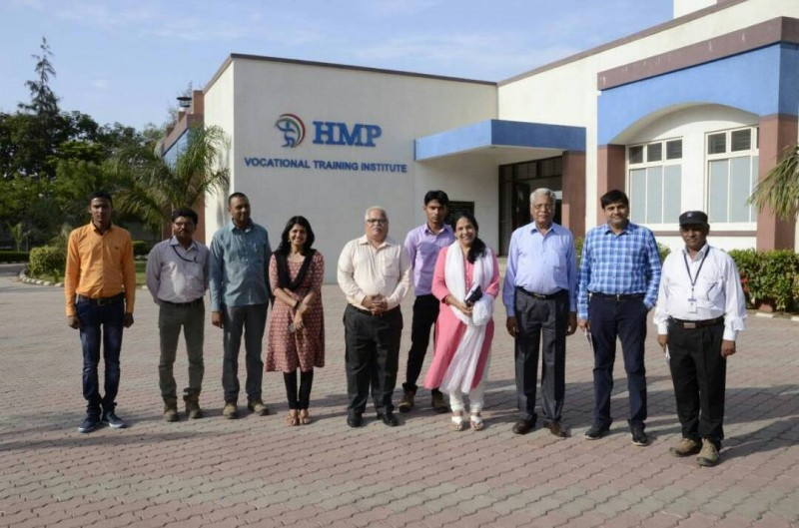
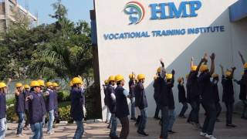
H
I
G
H
T
L
I
G
H
T
S

Slide 4
OUR
MISSION
Our mission is to educate students from all over Gujarat, including those from the local and rural areas, and from other countries, so they become enlightened individuals, improving the living standards of their families, industry and society. We will provide individual attention, world-class quality education and take care of character building.

Slide 5
OUR
VISION
We at HMP- VTI Campus will impart futuristic technical education and instill high patterns of discipline through our dedicated staff, which shall set global standards, making our students talented superior and ethically strong, who in turn shall improve the quality of life of the human race.

Slide 6
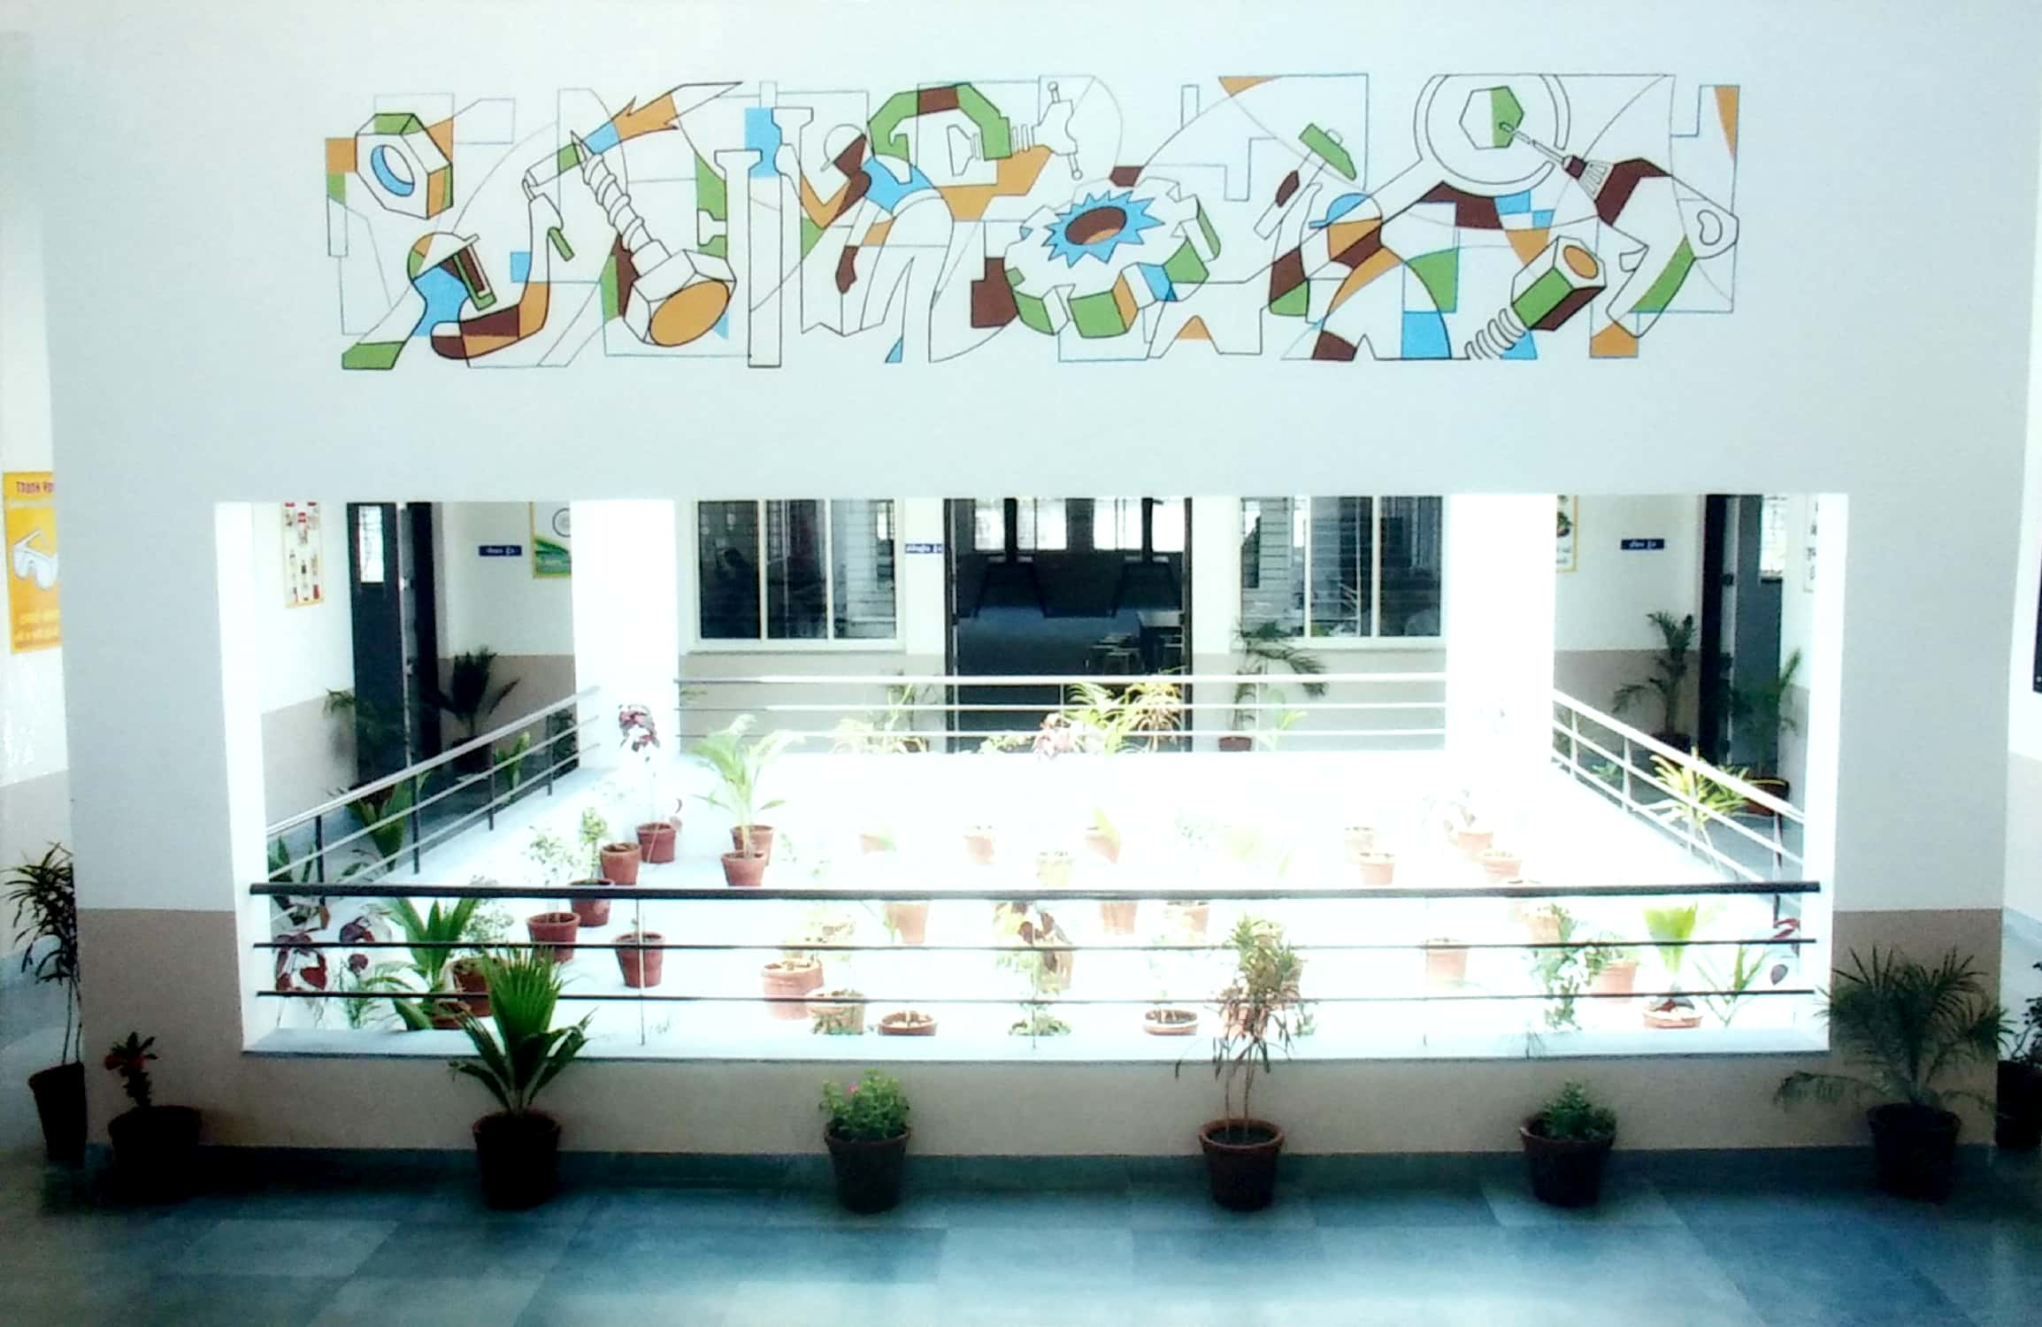
WHY HMP VOCATIONAL TRAINING INSTITUTE ?
The training institute will provide technical skills which will open up gainful employment opportunities for rural communities, simultaneously creating a pool of technical talents that will help industry flourish. The institute will thus follow the model of sustainability in action.
Equipped with the latest equipment, workshops and infrastructure, the institute will train about 200 students of BPL category every year. It will provide high-quality training and skills in identified areas, helping reduce the rising rate of unemployment to a great extent. There are 4 major GIDCs at Ankleshwar, Panoli, Dahej and Zagadia. Training in the institute is customised to meet the present needs of the industries at these GIDCs.

Slide 7
OUR TRADES
01
AOCP
02
FITTER
03
WELDER
04
ELECTRICAL

Slide 8
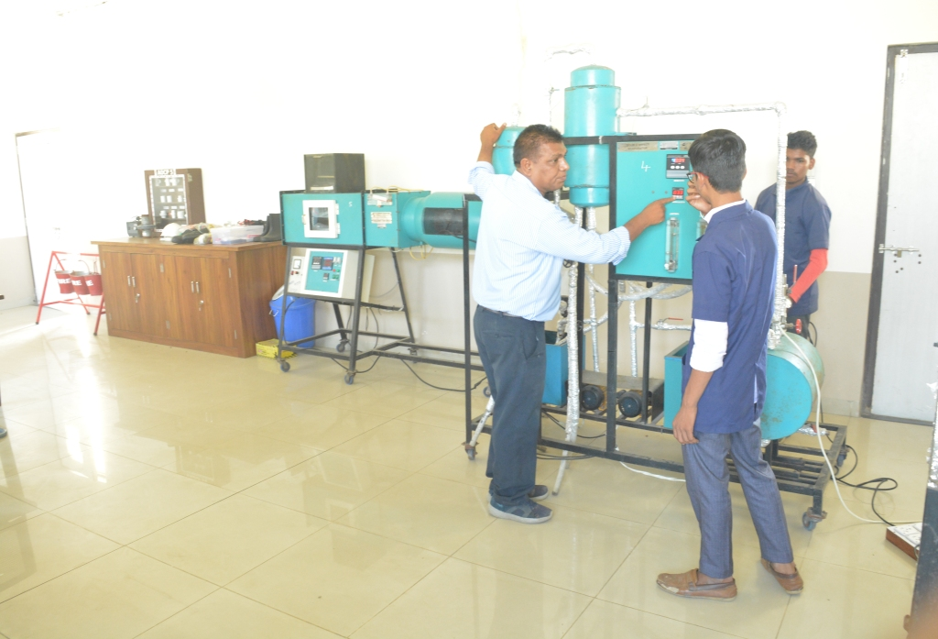
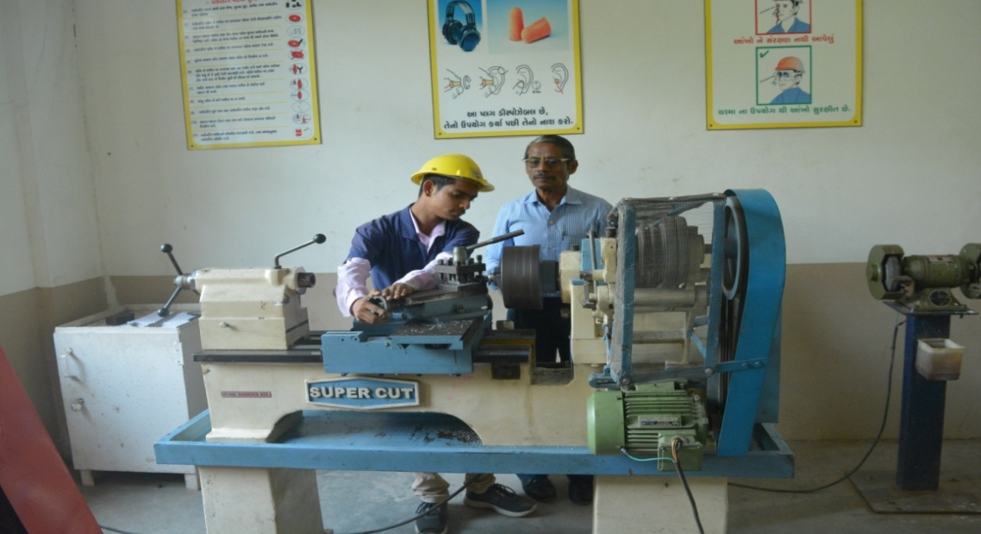
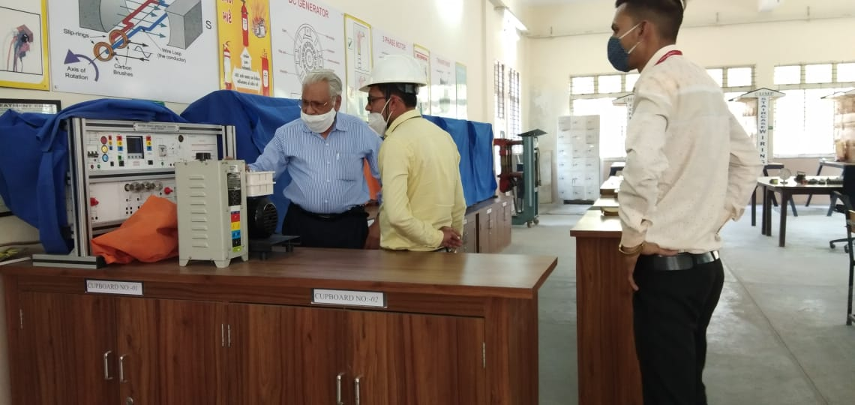
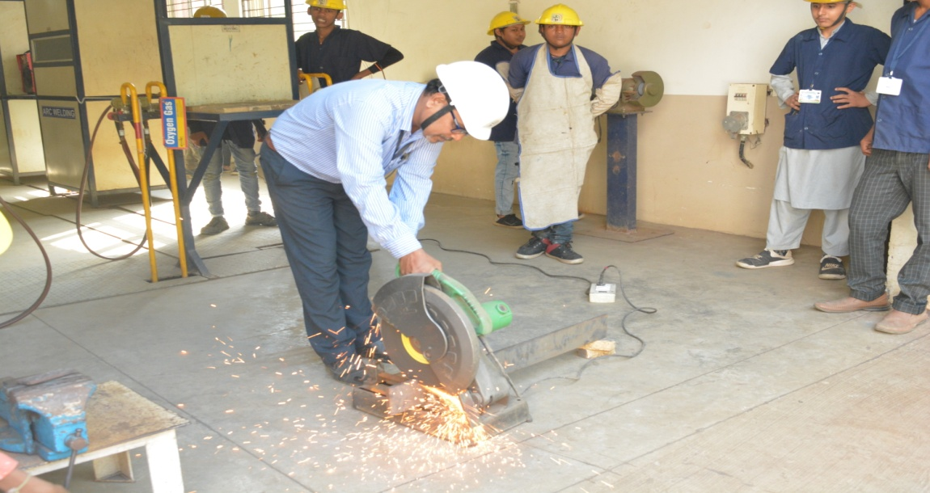
T
R
A
D
E
S
TRADE-AOCP
TRADE-FITTER
TRADE-ELECTRICAL
TRADE-WELDER
P
H
O
T
O
S

Slide 9
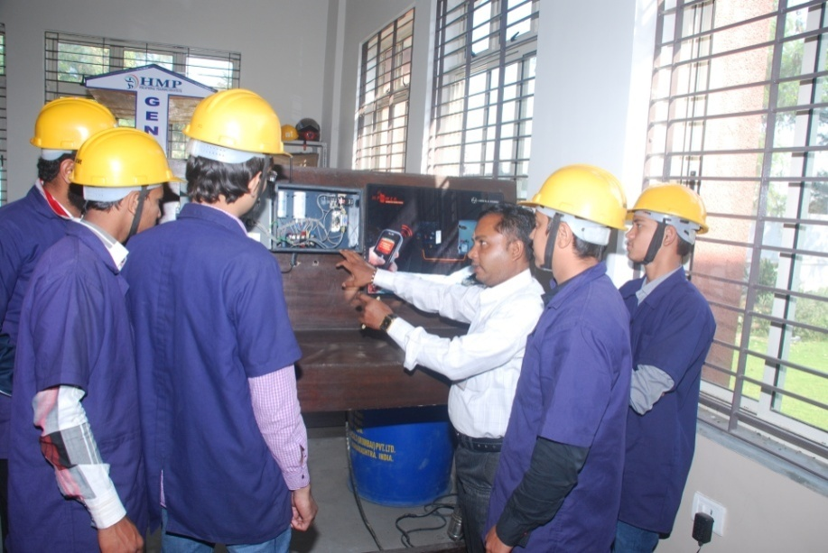
Industry Specific Training Electrician
Courses
ELECTRICIAN
Duration: 6 months
Location: KHAROD. ANKLESHWAR. BHARUCH
Knowledge/Placement Partner: L&T
Registration: Under the Skill Development Initiative Scheme
Eligibility Criteria:
Minimum - 10th pass
Age 17-30
Registration – Rs. 10
Deposit – Rs. 2000/-
NCVT Exam Fee as per guidelines.

Slide 10
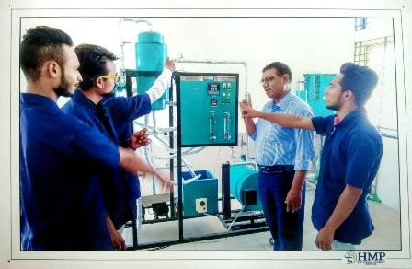
Industry Specific Training ATTENDANT OPERATOR OF CHEMICAL PLANT
Course - AOCP
Duration: 6 months
Location: KHAROD. ANKLESHWAR. BHARUCH
Knowledge/Placement Partner: L&T
Registration: Under the Skill Development Initiative Scheme
Eligibility Criteria:
Minimum - 10th pass
Age 17-30
Registration – Rs. 10
Deposit – Rs. 2000/-
NCVT Exam Fee as per guidelines.

Slide 11
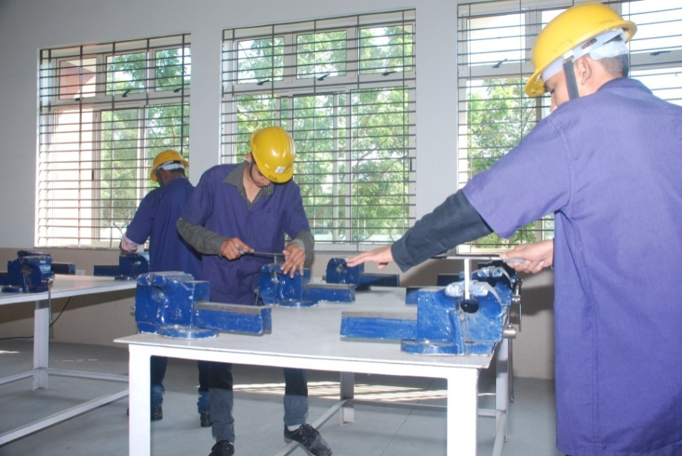
Industry Specific Training FITTER
Courses - FITTER
Duration: 6 months
Location: KHAROD. ANKLESHWAR. BHARUCH
Knowledge/Placement Partner: L&T
Registration: Under the Skill Development Initiative Scheme
Eligibility Criteria:
Minimum - 10th pass
Age 17-30
Registration – Rs. 10
Deposit – Rs. 2000/-
NCVT Exam Fee as per guidelines.

Slide 12
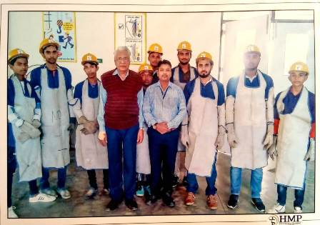
Industry Specific Training WELDER
Courses – WELDER
Duration: 6 months
Location: KHAROD. ANKLESHWAR. BHARUCH
Knowledge/Placement Partner: L&T
Registration: Under the Skill Development Initiative Scheme
Eligibility Criteria:
Minimum - 8th pass
Age 17-30
Registration – Rs. 10
Deposit– Rs. 2000/-
NCVT Exam Fee as per guidelines.

Slide 13
Charts defines the structure

Slide 14
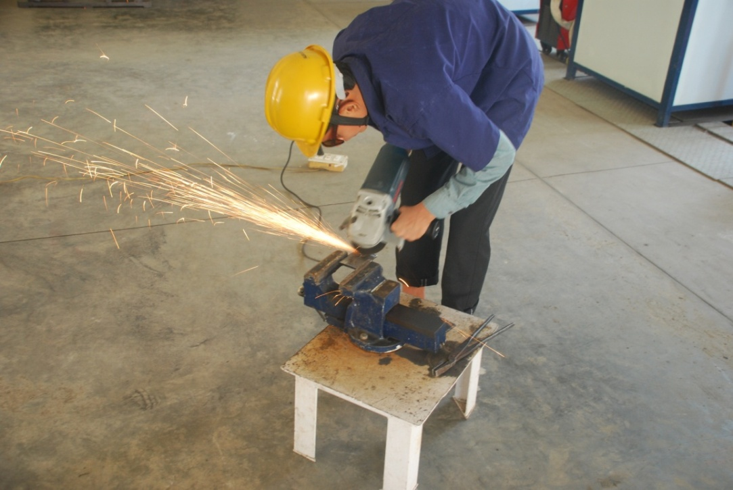
EMPLOYMENT OPPORTUNITIES
These training programmes will open up opportunities for the trainees in the industrial houses around Ankleshwar. The Programmes will give self-driven individuals the impetus to be self-employed.

Slide 15
FACULTY – INDUSTRY SUPPORT
Faculty-industry Support The institute’s faculty comprises active and retired professionals drawn form leading industrial organisations. Their vast experience will help in imparting skills in a systematic manner to the young trained professional electricians. Mechanics and technicians.
These training programmes will significantly change the attitude and mindset of the youth. and help in developing their help-esteem.
Support form industry leaders like Larsen & Toubro will assure that the courses are aligned with needs.

Slide 16
EXISTING FACILITIES & WORKSHOP OF AOCP
A.O.C.P TRADES
SAFETY MEASURES
CHEMICAL PROCESS
MATERIAL HANDLING
WORKING MODELS
VALVES
PERSONAL PROTECTIVE EQUIPMENTS
PLASTICS WARES
GLASS WARES
TYPES OF THERMOMETERS

Slide 17
EXISTING FACILITIES & WORKSHOP OF ELECTRICAL
ELECTRICAL TRADE
COMBINED WIRING
STAIRCASE WIRING
GODOWN WIRING
GENERAL WIRING
MOBILE STARTER & PUMPS
WINDING PROCESS
STAR DELTA STARTER REPAIRING
EARTHING PROCCES
DEMONSTRATION TABLES
XPO-MFS(3-∅ AC MOTOR FAULT SIMULATOR)
XPO-VIEW (VOLTAGE/CURRENT/ENERGY/ WATT MEASUREMENT TRAINER)
XPO-EMT (ELECTRICAL MACHINE TRAINER)
XPO-ETT (ELECTRO TECHNOLOGY TRAINER)
XPO-ITT ( INDUSTRIAL INSTALLATION TRAINER)
DIGITAL OSCILLOSCOPE
AHUJA SPEAKER

Slide 18
EXISTING FACILITIES & WORKSHOP OF FITTER
FITTER TRADE
LATHE MACHINE
DRILLING MACHINE
VARIOUS TYPES OF FILES
BENCH VISE
DEMONSTRATION TABLE
PILLAR TYPE DRILLING MACHINE MODEL NO-PRL-25
BENCH DRILL MACHINE
ELECTRICAL PORTABLE WELDING MACHINE

Slide 19
EXISTING FACILITIES & WORKSHOP OF WELDER
WELDER TRADE
SAFETY MEASURES
GAS CUTTING
GAS WELDING
ARC WELDING
TIG WELDING
MIG WELDING
HAND SHEARING MACHINE

Slide 20
LIST OF INDUSTRIES
MOTI ELECTROMAC PVT LTD
SULPHUR MILLS
CHEMINOVA INDIA LTD
BABA ELECTRICALS
GINNI FILAMENTS LTD.
FIVE BROS
GODREJ INDUSTRIAL LTD.
UNIQUE PHARMACEUTICALS
EAGLE WELDING WORKS
AMI ENGINEERING
UNITED PHOSPHOROUS LTD
JALARAM WELDING WORKS
RAJESH ENGINEERING WORKS
HITECH ENGINEERING WORKS
BECTO CHEMICALS PANOLI
WORKHARDT LIMITED
SHAILESH ENGINEERING WORKS
GANGAMANI ENTERPRISE
NEW M.G ELECTRICALS
PANORAMA AEROMATICS
SUN PHARMACEUTICALS
BRAHMANI ELECTRICALS
PIYUSH ELECTRICALS
G.I.P.C.L PVT LTD
JAY ENGINEERING WORKS
BIRLA CELLULOSE LTD
AGRO PACK PANOLI
RECYCLE SOLUTION PROCESS UNIT
BODEL CHEMICALS
RIDDHI PHARMA

Slide 21
HMP
VOCATIONAL TRAINING INSTITUTE
“MANAGED BY THE ANKLESHWAR PROGRESSIVE EDUCATION TRUST”
Nr. PUBLIC SCHOOL, N. H. NO. - 8,
AT. VILLAGE – KHAROD.
TAL. – ANKLESHWAR, DIST. – BHARUCH. 394115
Ph. 02646-276919
MAIL :- hmpvti@gmail.com WEB:- www.hmpvti.org
THANK YOU

